Slide 1

Biohackers and Anticipatory Governance
Eben Kirksey
Associate Professor of Anthropology
Deakin University

Slide 2
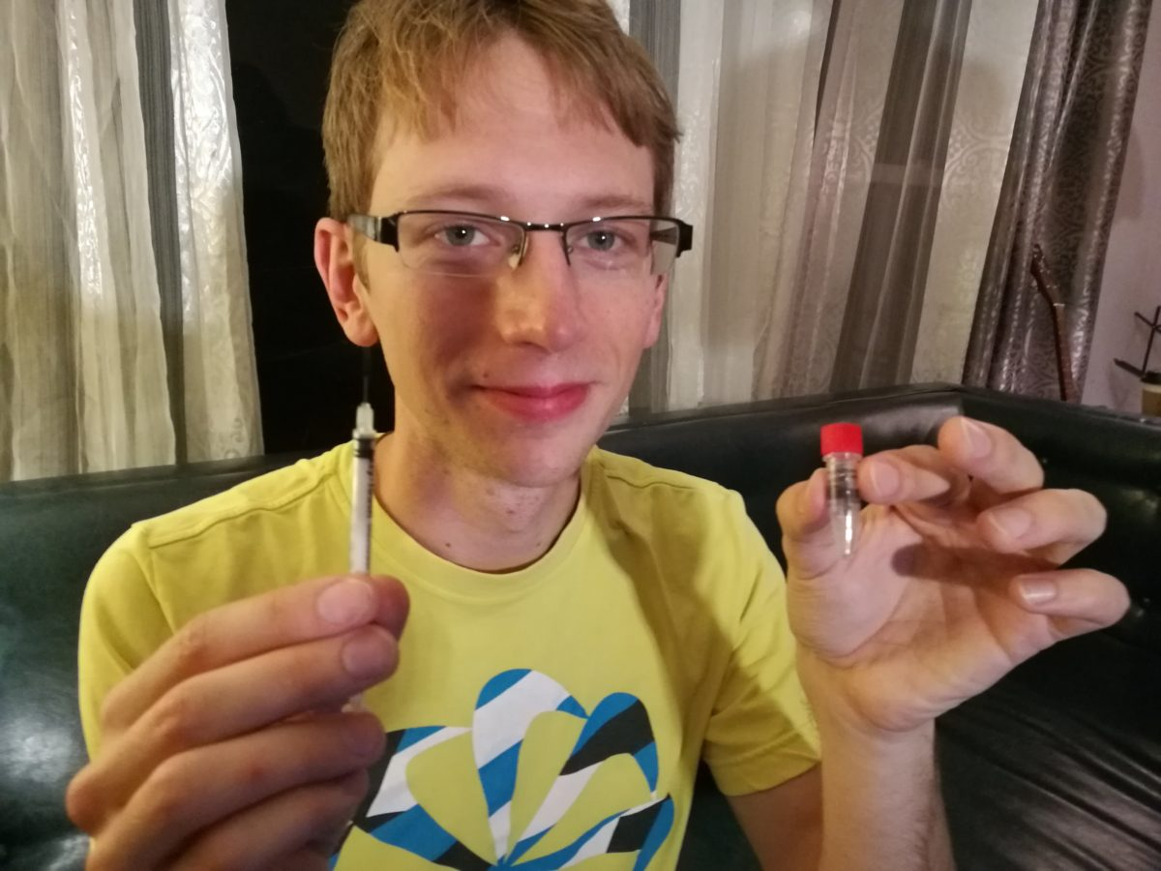

Slide 3


Slide 4
